Slide 2
Getting Started with Microservices
David Rodríguez - @davidjrh
César Abreu - @cesabreu

Slide 3





About
David Rodríguez
CTO at Intelequia Software Solutions
Cloud Team Lead Engineer at DNN Corp.
Microsoft Azure MVP/Insider
César Abreu
Cloud Solutions Architect at Intelequia Software Solutions
Microsoft Azure MVP/Insider
http://davidjrh.intelequia.com
@davidjrh
http://cesarab.intelequia.com
@cesabreu

Slide 4
On this session
Principles and best practices for building Microservices
A developer approach for building and consuming Microservices
Continuous integration and delivery
10:30-11:30 - VSTS Deep Dive: Build & Release (Ibón Landa, Track 8)
12:15-13:15 - Creación de tareas personalizadas de Build y Release Management (Luis Fraile, Track 8)
Service Fabric introduction

Slide 5
The Challenge
MODERNIZE
Back End
New Application
CHALLENGES
Front End
An Eco-System
2002
Webforms
Terrible UI /UX
Not SaaS
Multi Instance Architecture

Slide 6
The Challenge
Back End
CHALLENGES
Front End
2002
Webforms
Terrible UI /UX
Not SaaS
Multi Instance Architecture
MODERNIZE

Slide 7
Microservices: New Features as a Service
External Developers
API
Back End
New Feature 1
New Feature 2
New Feature x
DNN Cloud Infrastructure
Front End
NEW APPLICATION
Modern Tech
Cloud
True SaaS
Other CMS
Independent
Service
App

Slide 8

New Feature as a Service

Slide 9
DEMO
Structured Content on Evoq 8.5

Slide 10
What is a Microservice?
Is (logic + state) that is independently versioned, deployed, and scaled
Has a unique name that can be resolved
e.g. fabric:/myapplication/myservice
Interacts with other microservices over well defined interfaces and protocols like REST
Remains always logically consistent in the presence of failures
Hosted inside a “container” (code + config)
Can be written in any language and framework
node.js, Java VMs, any EXE, .NET
Developed by a small engineering team

Slide 11
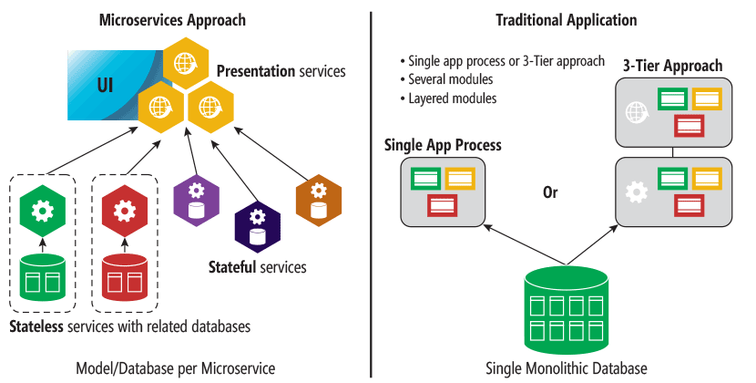
Monolithic vs. Microservices
Source: https://msdn.microsoft.com/en-us/magazine/mt595752.aspx

Slide 12
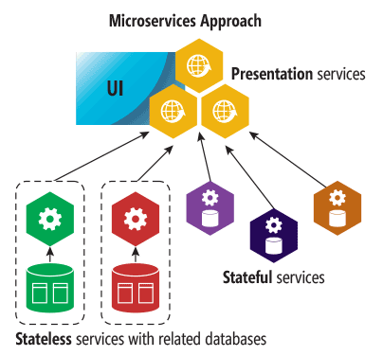
Type of microservices
Stateless microservice
Has either no state or it can be retrieved from an external store
There can be N instances
e.g. web frontends, protocol gateways, Azure Cloud Services etc.
Stateful microservice
Maintain hard, authoritative state
N consistent copies achieved through replication and local persistence
e.g. database, documents, workflow, user profile, shopping cart etc.

Slide 13
Building Features as a Service – Key principles
Domain Driven Design: focus on the feature (the domain).
Each microservice is relatively small, easier for a developer to understand
Faster IDE, enhancing productivity
Faster deployments
High rate of change, low cost of change
Hide implementation details
Decentralization: scaling by feature, not by the whole
Failure isolation: more resistant than a monolithic structure
Continuous Delivery through DevOps Culture

Slide 14
Best Practices for Designing Microservices
Create a Separate Data Store for Each Microservice
Keep Code at a Similar Level of Maturity
Do a Separate Build for Each Microservice
Deploy in Containers (or container like)
Treat Servers as Stateless, avoid individual servers dependencies
Think for Big but also for business continuity:
How the data will be backed up or restored?
How the data will be partitioned by tenant?

Slide 15
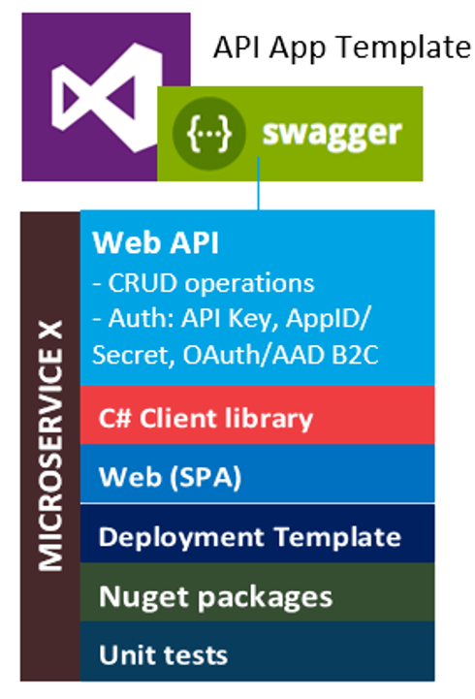
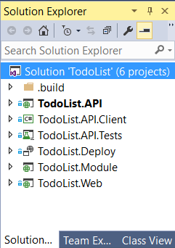
A .NET developer approach to Microservices

Slide 16
DEMO
A .NET developer approach to Microservices

Slide 17
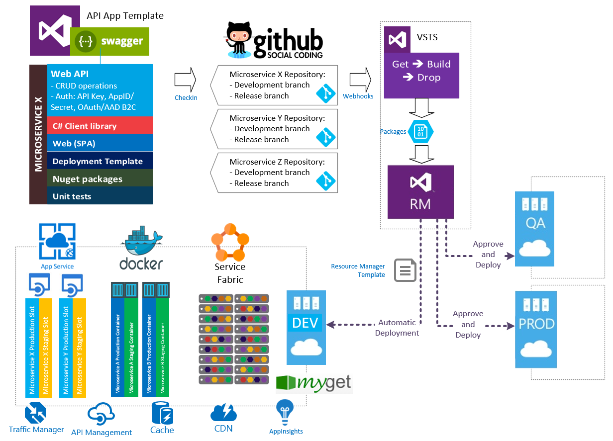

Slide 18
DEMO
Continuous integration and delivery with VSTS

Slide 19
Microsoft Azure Service Fabric A platform for reliable, hyperscale, microservice-based applications
Microservices
Service Fabric
Container Orchestration & lifecycle management
Application Programming Models
High Availability
Hybrid Operations
Data Partitioning
Health Monitoring
Self-healing
Simple programming models
High Density
Rolling Upgrades
Low Latency
Placement Constraints
Replication & Failover
Stateful services
Fast startup & shutdown
Load balancing
Hyper-Scale
Automated Rollback
Windows
Server
Linux
Windows
Server
Linux
Azure
Hosted Clouds
Windows
Server
Linux
Private Clouds

Slide 20
Battle-hardened for over 5 years
Azure Document DB
billions transactions/week
Intune
800k devices
Azure Core Infrastructure
thousands of machines
Skype for Business
Hybrid Ops
Bing Cortana
500m evals/sec
Azure SQL Database
1.4 million databases
Event Hubs
20bn events/day
Power BI

Slide 21
DEMO
Service Fabric
Notes:
DEMO SCRIPT:
Show the Web Platform Installer and see how to install the Azure Service Fabric SDK (that installs Visual Studio templates as well as the Service Fabric emulator)
Show the local emulator and show the “Cluster Map”, explaining the upgrade domains and fault domains
Open Visual Studio and show the Service Fabric template, with the different service Fabric models
Open the TodoListFabric.sln and show the parts
Start debugging it with Local.1Node.xml
Show how to deploy on Azure
Show how to create a service fabric cluster
Show the created cluster
Show http://techsummit.northeurope.cloudapp.azure.com/api/values

Slide 22
Takeaways
Start building Microservices today, don’t feed the monster anymore
Microservices architecture is not new, you have consumed them for years

Slide 23


Questions?

Slide 24

Gracias
http://aka.ms/MTS32

